Slide 1
Machine Learning
Machine Learning Introduction to Machine Learning by Kumar Anurupam is licensed under a Creative Commons Attribution-4.0 International License.
Clustering – K-means clustering
CS 3104 Fall 2019
Lecture Slides by Kumar Anurupam

Slide 2
Learning Objective
After the completion of today’s lesson students will be able to:
Describe the concept of k-means clustering
Solve problems on k-means clustering.

Slide 3
K-means introduction
It is a typical clustering analysis approach via iteratively partitioning training data set to learn a partition of the given data space.
Based on learning a partition on a data set to produce several non-empty clusters (usually, the number of clusters given in advance)
It is similar to the expectation-maximization algorithm for mixtures of Gaussians in that they both attempt to find the centers of natural clusters in the data.
In principle, optimal partition achieved via minimizing the sum of squared distance to its “representative object” in each cluster:
Where,
k = number of clusters
C_{i} = ith cluster
c_{i} = Centroid/Medoid of i^{th} cluster
p = Points in cluster i^{th} cluster

Slide 4
K – means algorithm
Decide on a value for k.
Initialize the k cluster centers (randomly, if necessary).
Decide the class memberships of the N objects by assigning them to the nearest cluster center.
Re-estimate the k cluster centers, by assuming the memberships found above are correct.
If none of the N objects changed membership in the last iteration, exit. Otherwise goto 3.

Slide 5
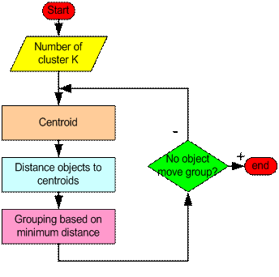
K- means algorithm Flowchart

Slide 6
Strengths and Weakness of k-means
Strengths
Relatively efficient: O(tkn), where n is # objects, k is # clusters, and t is # iterations. Normally, k, t << n.
Often terminates at a local optimum. The global optimum may be found using techniques such as simulated annealing and genetic algorithms
Weaknesses
Applicable only when mean is defined (what about categorical data?)
Need to specify k, the number of clusters, in advance
Trouble with noisy data and outliers
Not suitable to discover clusters with non-convex shapes

Slide 7
Numerical
Cluster the following eight points(with (x,y) representing locations) into three clusters A1(2,10), A2(2,5), A3(8,4), A4(5,8), A5(7,5), A6(6,4), A7(1,2) and A8(4,9).
Initial cluster centers are A1(2,10), A4(5,8) and A7(1,2)
The distance function used is manhattan distance

Slide 8
Thank you

